Slide 1
Application of Deep and Reinforcement Learning to Boundary Control Problems
Presented by:
Zenin Easa Panthakkalakath
Under the guidance of:
Prof. Dr. Olaf Schenk, Dr. Juraj Kardoš
Notes:
Good morning everyone,
Thank you for being here to listen to me talk about my master thesis project on Application of Deep and Reinforcement Learning to Boundary Control Problems.

Slide 2


Introduction: Boundary control problem
Boundary cell values are controllable.
Domain values follow an elliptic PDE.
Domain cells have desired values.
Both domain and boundary cells have upper and lower bound constraints.
Find the most optimal values for the boundaries such that the domain would be closest to the desired values, without violating the constraints.
u
$$∈Γ, boundary$$
y
$$∈Ω, domain$$
Zenin Easa Panthakkalakath
16 June 2023
Notes:
Talk about hypothetical room with people, icecream and food.

Slide 3
Introduction: Boundary control problem
Desired state
Optimal solution
Desired state
Optimal solution
Zenin Easa Panthakkalakath
16 June 2023
Notes:
If the desired profile is simple, it is easy to achieve the same, as you can see in the figure shown here.
Note: To make these plots we used Poisson's equation as the PDE, which has a sourcing term, unlike temperature profile example that we talked about.

Slide 4
Objective
Identify how/where deep learning and reinforcement learning methods can be applied to tackle boundary control problems.
Apply deep learning and reinforcement learning methods and compare the accuracy and performance with traditional methods.
Zenin Easa Panthakkalakath
16 June 2023

Slide 5
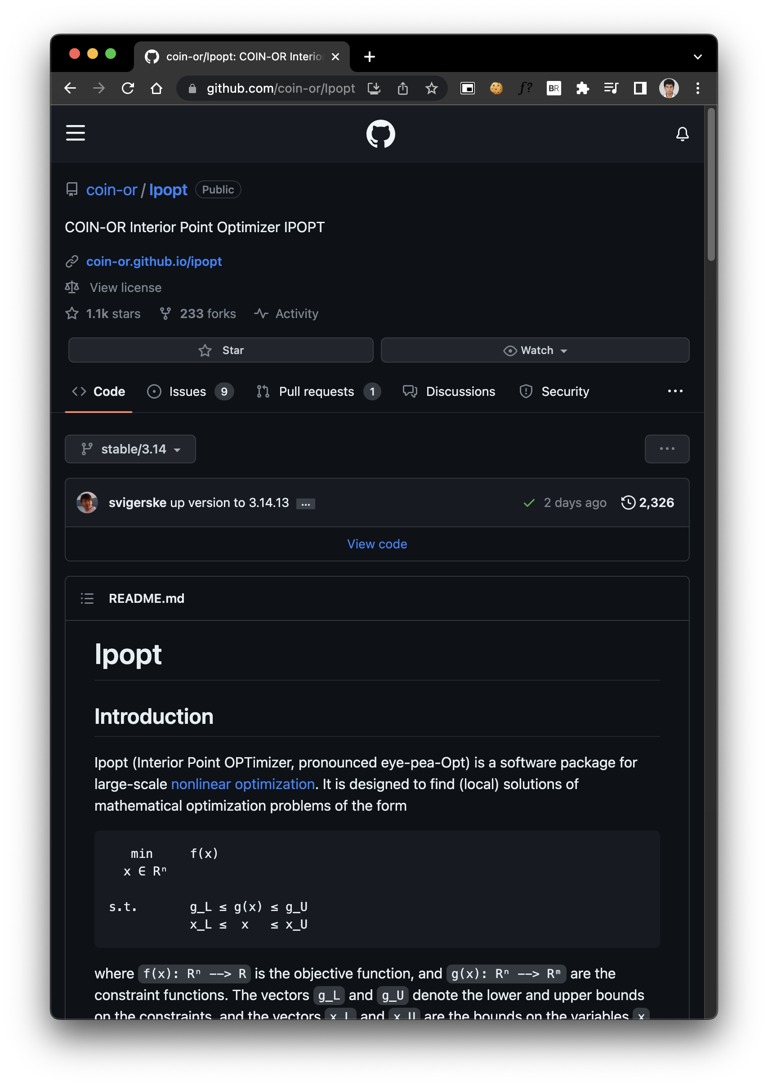
Interior Point OPTimizer (IPOPT)
State-of-the-art for solving optimization problems including boundary control problems.
Uses primal-dual interior-point method
Also uses filter line-search to keep a track of previously explored points in the solution space and avoid revisiting these
Zenin Easa Panthakkalakath
16 June 2023

Slide 6
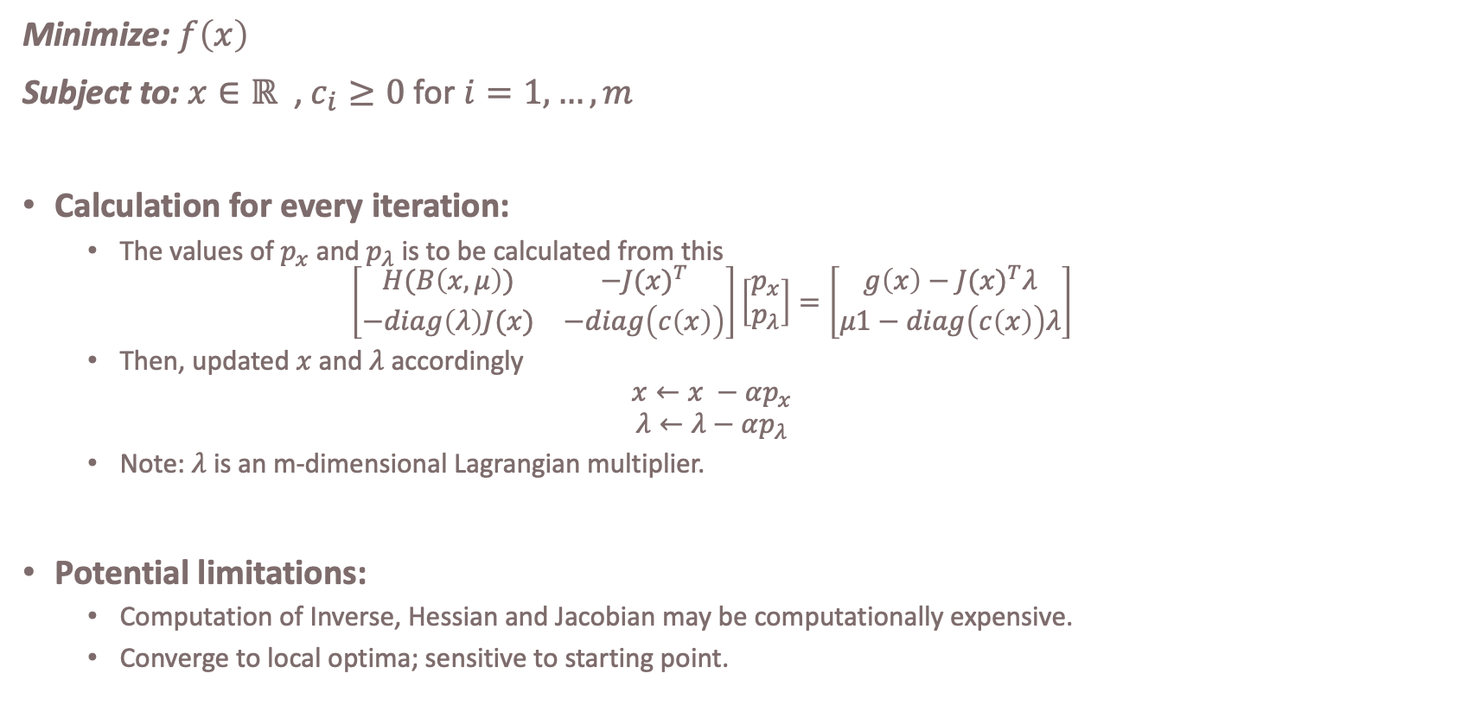
Primal-Dual Interior Point Method
Minimize: $f\left(x\right)$
Subject to: $x∈ℝ$ , $c_{i}≥0$ for $i=1, …,m$
Calculation for every iteration:
The values of $p_{x}$ and $p_{λ}$ is to be calculated from this
$$\left[\begin{matrix}H(B\left(x,μ\right)) & {−J(x)}^{T} \\ −diag\left(λ\right)J(x) & −diag\left(c\left(x\right)\right)\end{matrix}\right]\left[\begin{matrix}p_{x} \\ p_{λ}\end{matrix}\right]=\left[\begin{matrix}g\left(x\right)−{J(x)}^{T}λ \\ μ1−diag\left(c\left(x\right)\right)λ\end{matrix}\right]$$
Then, updated $x$ and $λ$ accordingly
$$x←x −αp_{x}$$
$$λ←λ−αp_{λ}$$
Note: $λ$ is an m-dimensional Lagrangian multiplier.
Potential limitations:
Computation of Inverse, Hessian and Jacobian may be computationally expensive.
Converge to local optima; sensitive to starting point.
Zenin Easa Panthakkalakath
16 June 2023
Notes:
The key mathematical intuition behind IPOPT is Interior Point Method. You can observe the kind of computation that happens at each step in this method.

Slide 7

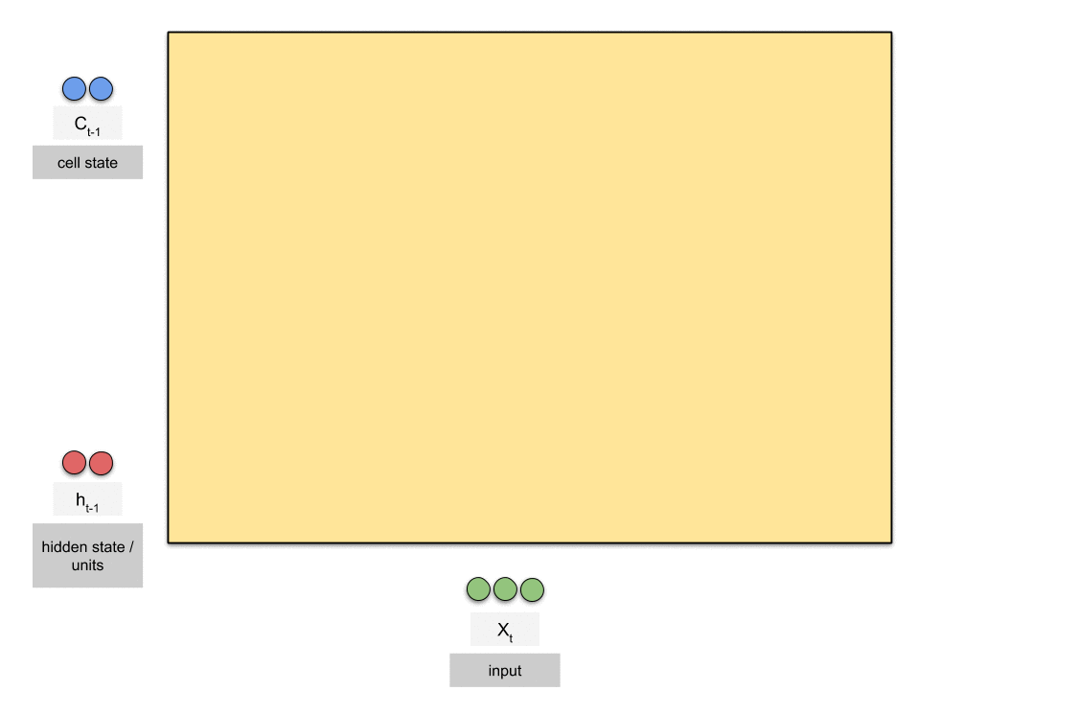
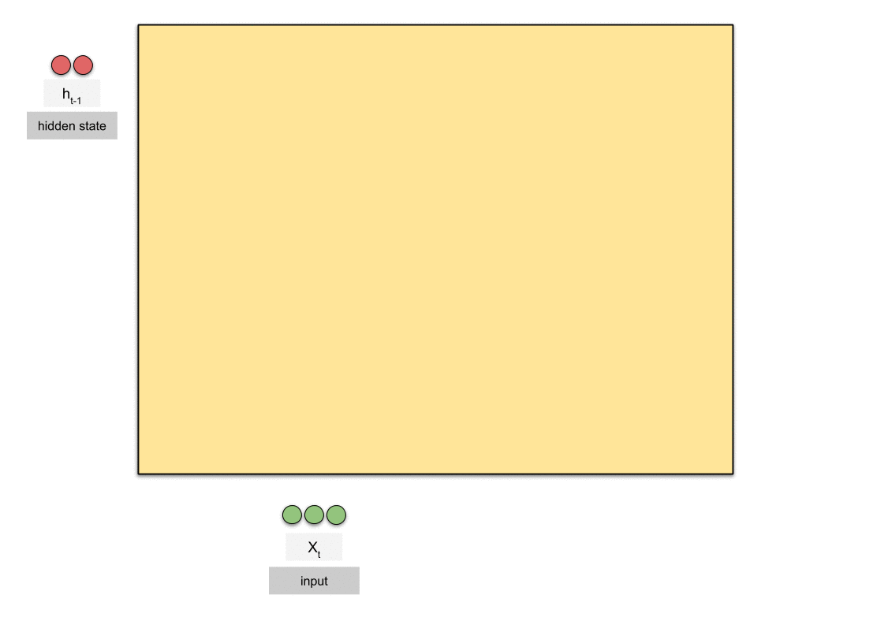
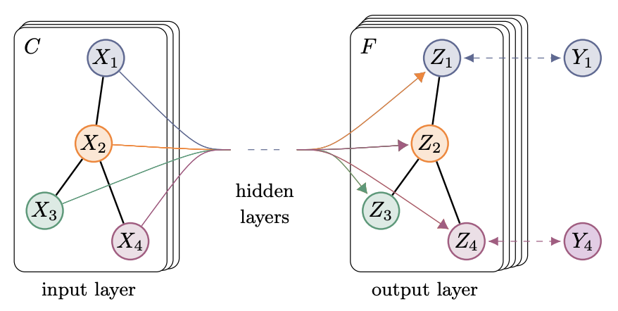
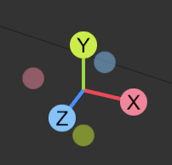
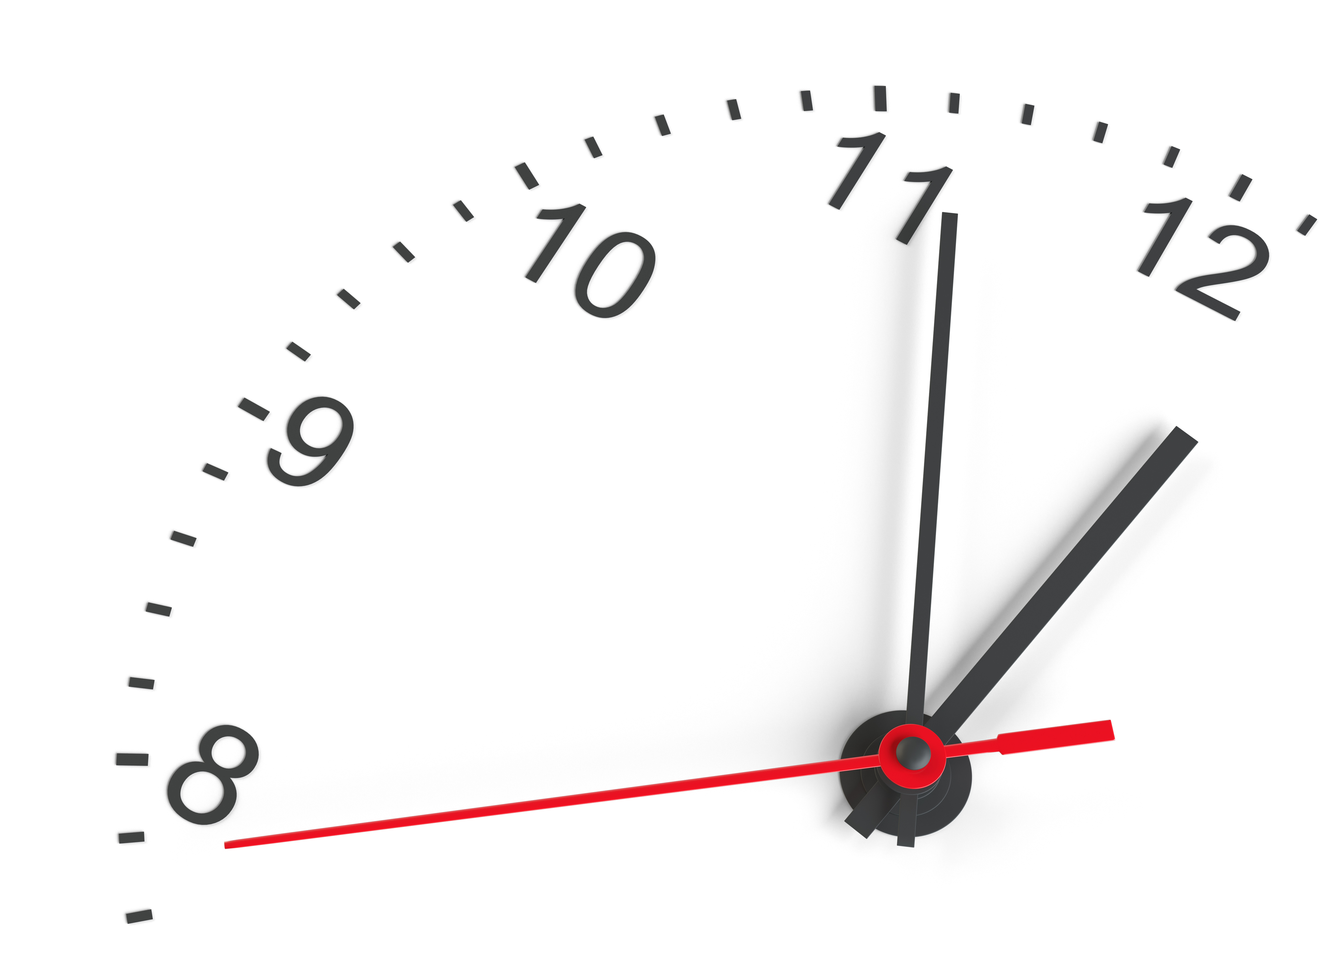
Deep Learning
Convolution neural network
Recurrent neural network
LSTM
GRU
Source: hannibunny.github.io
Source: towardsdatascience.com
Graph neural network
Spatio-temporal neural network
Source: Kipf, Welling
Zenin Easa Panthakkalakath
16 June 2023
Notes:
Deep learning is regarded as universal function approximators. Here are a few categories of neural networks important in this project.

Slide 8
Reinforcement Learning
ACTOR
State
Policy
Action
Policy Update
Learning algorithm
Reward
ENVIRONMENT
Zenin Easa Panthakkalakath
16 June 2023
Notes:
Reinforcement learning is a mechanism by which an actor attempts to learn by interacting with an environment. This diagram represents reinforcement learning from a high-level.

Slide 9
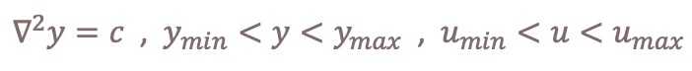
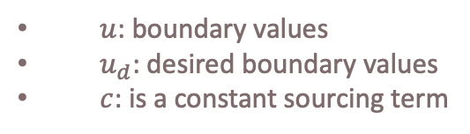
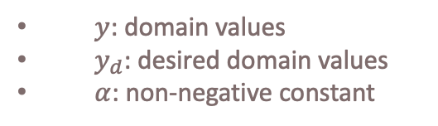
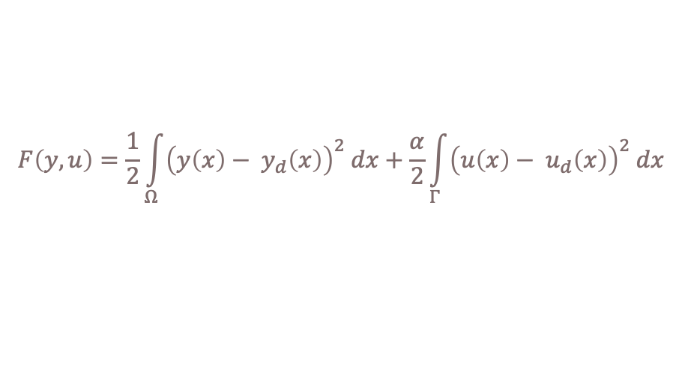
Methodology: Defining cost and reward
Minimize:
$$F\left(y,u\right)=\frac{1}{2}\int_{Ω}^{ }{{\left(y\left(x\right)− y_{d}\left(x\right)\right)}^{2} dx}+\frac{α}{2}\int_{Γ}^{ }{{\left(u\left(x\right)− u_{d}\left(x\right)\right)}^{2} dx}$$
Subject to:
$∇^{2}y=c$ , $y_{min}<y<y_{max}$ , $u_{min}<u<u_{max}$
$y$: domain values
$y_{d}$: desired domain values
$α$: non-negative constant
$u$: boundary values
$u_{d}$: desired boundary values
$c$: is a constant sourcing term
u
$$∈Γ, boundary$$
y
$$∈Ω, domain$$
Zenin Easa Panthakkalakath
16 June 2023
Notes:
In a pure mathematical sense, boundary control problems can be described as shown here.
The objective function itself could be used as a cost function; however, it is better if the inequality constraints are also incorporated into it.
The constraint related to the PDE is addressed by …

Slide 10
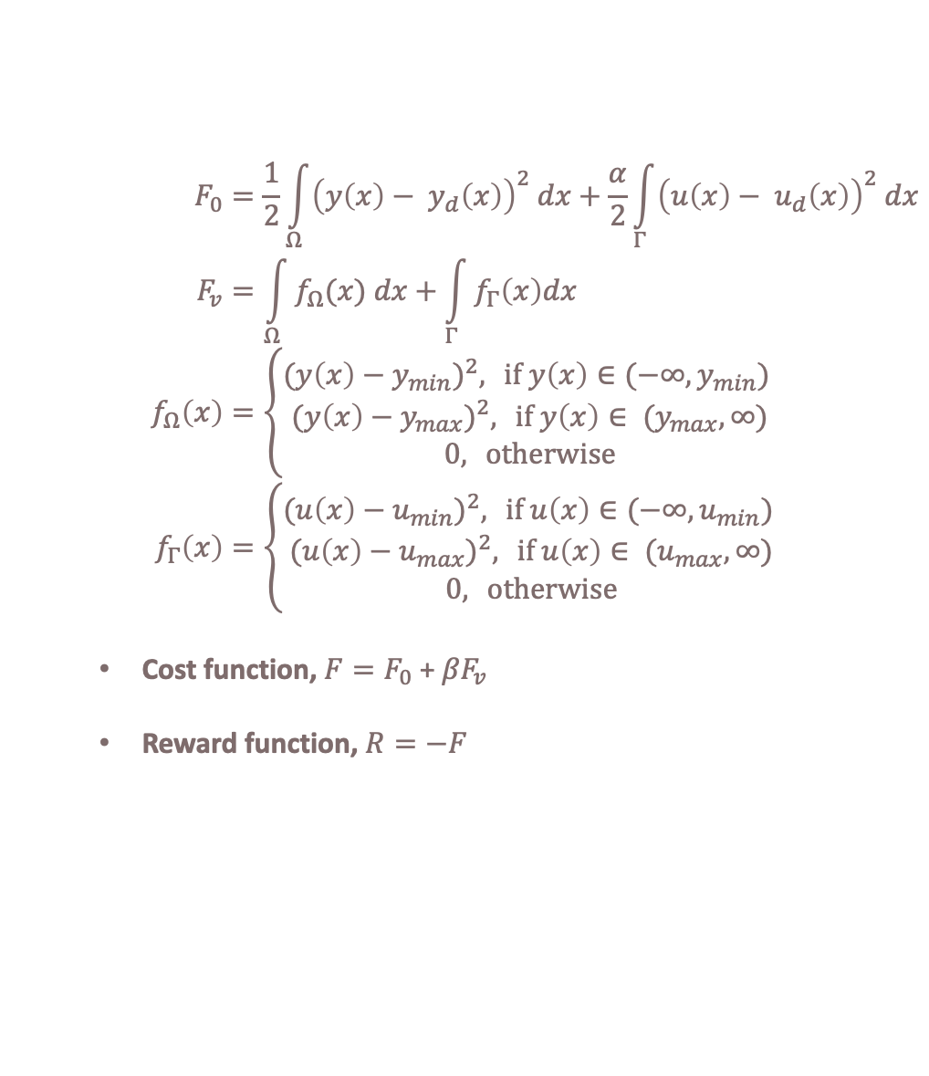
Methodology: Defining cost and reward
$$F_{0}=\frac{1}{2}\int_{Ω}^{ }{{\left(y\left(x\right)− y_{d}\left(x\right)\right)}^{2} dx}+\frac{α}{2}\int_{Γ}^{ }{{\left(u\left(x\right)− u_{d}\left(x\right)\right)}^{2} dx} \\ F_{v}=\int_{Ω}^{ }{f_{Ω}(x) dx}+\int_{Γ}^{ }{f_{Γ}\left(x\right)dx} \\ f_{Ω}\left(x\right)=\left\{\begin{aligned}{(y\left(x\right)−y_{min})}^{2}, \text{if} y\left(x\right)∈(−∞,y_{min}) \\ {(y\left(x\right)−y_{max})}^{2}, \text{if} y\left(x\right)∈ (y_{max},∞) \\ 0, \text{otherwise}\end{aligned}\right. \\ f_{Γ}\left(x\right)=\left\{\begin{aligned}{(u\left(x\right)−u_{min})}^{2}, \text{if} u\left(x\right)∈(−∞,u_{min}) \\ {(u\left(x\right)−u_{max})}^{2}, \text{if} u\left(x\right)∈ (u_{max},∞) \\ 0, \text{otherwise}\end{aligned}\right.$$
Cost function, $F=F_{0}$ + ${βF}_{v}$
Reward function, $R=−F$
u
$$∈Γ, boundary$$
y
$$∈Ω, domain$$
Very large
Zenin Easa Panthakkalakath
16 June 2023
Notes:
We use a quadratic barrier function to incorporate the inequality constraints.
<click>

Slide 11
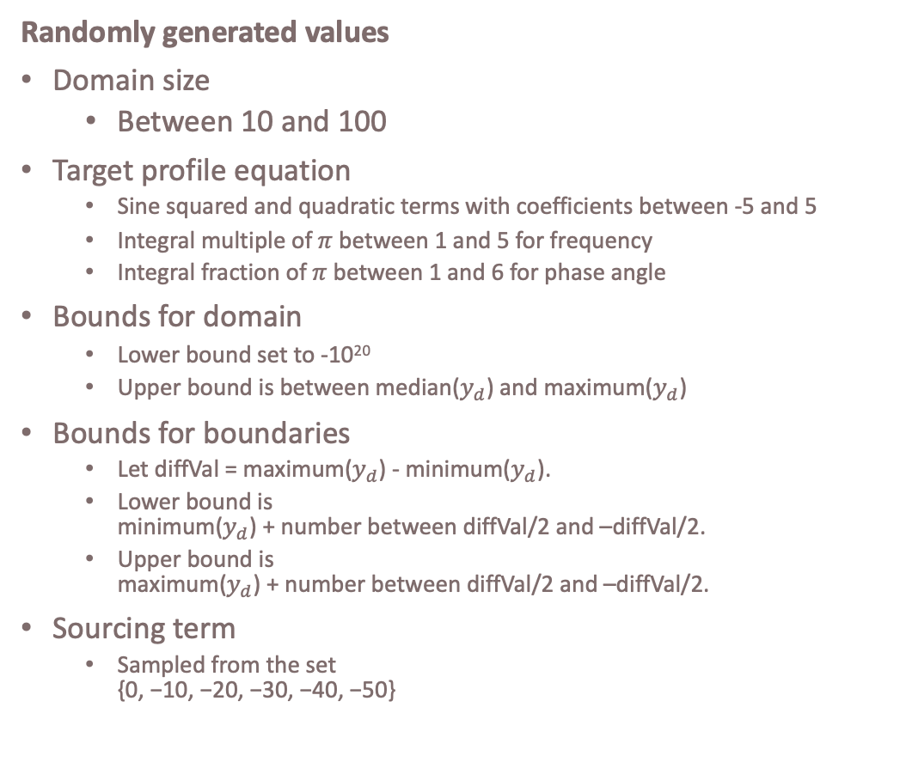
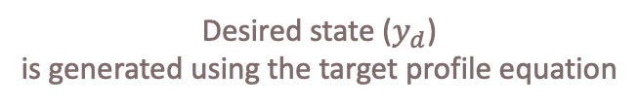
Methodology: Data generation
Randomly generated values
Domain size
Between 10 and 100
Target profile equation
Sine squared and quadratic terms with coefficients between -5 and 5
Integral multiple of $π$ between 1 and 5 for frequency
Integral fraction of $π$ between 1 and 6 for phase angle
Bounds for domain
Lower bound set to -10²⁰
Upper bound is between median($y_{d}$) and maximum($y_{d}$)
Bounds for boundaries
Let diffVal = maximum($y_{d}$) - minimum($y_{d}$).
Lower bound is minimum($y_{d}$) + number between diffVal/2 and –diffVal/2.
Upper bound is maximum($y_{d}$) + number between diffVal/2 and –diffVal/2.
Sourcing term
Sampled from the set {0, −10, −20, −30, −40, −50}
Desired state ($y_{d}$) is generated using the target profile equation
Zenin Easa Panthakkalakath
16 June 2023
Notes:
Now, to train deep learning and reinforcement learning models, we need data; lots of data. This is generated synthetically by taking inspiration from a paper by Maurer and Mittelmann related to boundary control problems and interior point optimization. The paper only describes four problems with dirichlet boundary conditions, and we desire thousands of problems to train the network.
Therefore, we randomly generate values for the same.
<click> .... <click> ....

Slide 12
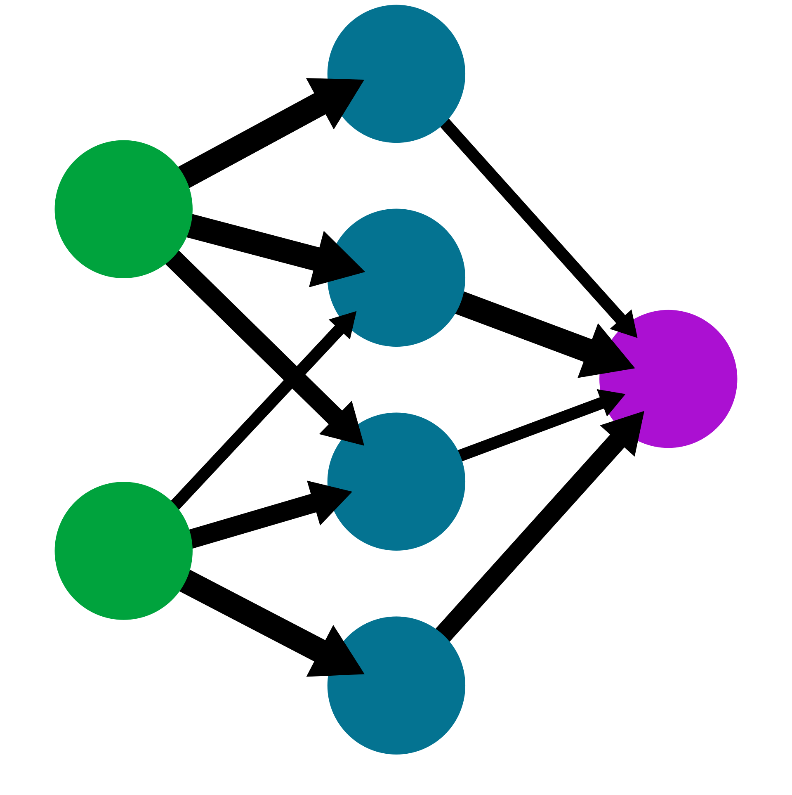

Methodology: High-level architecture
Start with a problem
Guess boundary
Initial guess network
Should be able to have lower cost than any trivial methods; which are:
the mean of the desired domain.
the median values of the desired domain.
the values at the edges of the desired domain.
Use DL to make informed guess
Calcualte cost
Using cost and optimizer, update boundary
Optimizer network
This is compared against SGD, Adam and IPOPT.
Use DL and RL to make a better optimizer method
If converged or reached max iterations
No
Essentially RL mechanism
Yes
Return boundary
Zenin Easa Panthakkalakath
16 June 2023

Slide 13
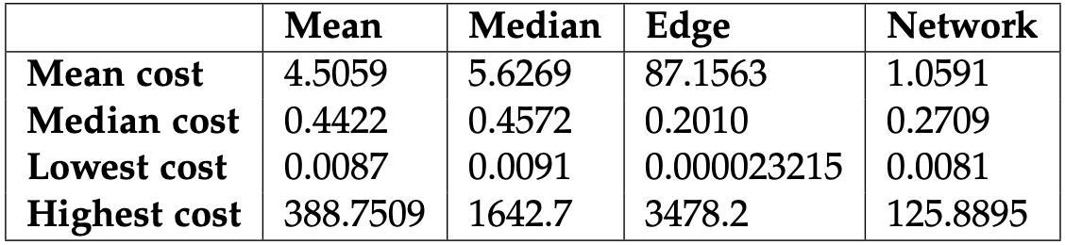

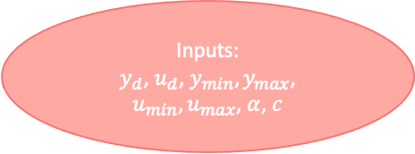
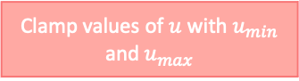
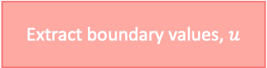
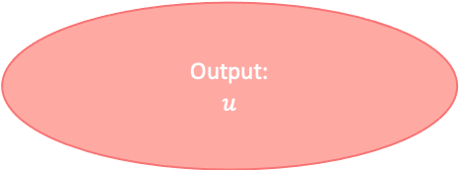
Results: Initial guess network
Inputs:
$y_{d}$, $u_{d}$, $y_{min}, y_{max}$, $u_{min},u_{max}$, $α$, $c$
Conv layer with
ReLu activation
Conv layer with
ReLu activation
Clamp values $y_{d}$ with $y_{min} and y_{max}$
Add back subtracted minimum value
Remove effects of sourcing term
Extract boundary values, $u$
Subtract with minimum value
Clamp values of $u$ with $u_{min}$ and $u_{max}$
Conv layer with
ReLu activation
Output:
$$u$$
Conv layer with
ReLu activation
Zenin Easa Panthakkalakath
16 June 2023

Slide 14
Results: Initial guess network
Mean
Median
Edge
Network
Cumulative
Zenin Easa Panthakkalakath
16 June 2023

Slide 15
Results: Initial guess network
Cumulative
Zenin Easa Panthakkalakath
16 June 2023

Slide 16
Analysis: Comparative Analysis of Initial Guess Network and Edge values
Zenin Easa Panthakkalakath
16 June 2023
Notes:
To understand if there is a pattern to when Edge values outperform Initial Guess Network, partial correlation between the problem parameters and cost differences between Initial Guess Network and Edge method were conducted. It was observed that the cost difference has a significant correlation with the sourcing term values.

Slide 17
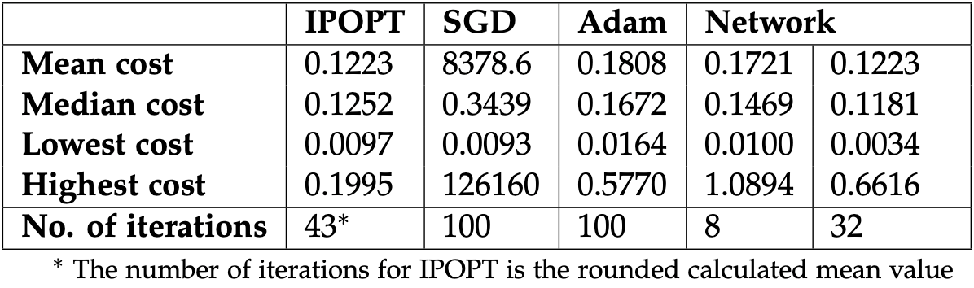
Results: Optimizer network
Inputs: u, g
(g is gradients of u w.r.t. cost)
Adam
Calculate g², g³
RMSProp
Conv+LSTM layer with ReLu activation
Conv+LSTM layer with ReLu activation
Conv layer with
ReLu activation
Multiplication with
sign of g
Linear layer
Input: empty
Output: Learning rates
Update u
Output: u
Zenin Easa Panthakkalakath
16 June 2023

Slide 18
Results: Optimizer network
Zenin Easa Panthakkalakath
16 June 2023

Slide 19
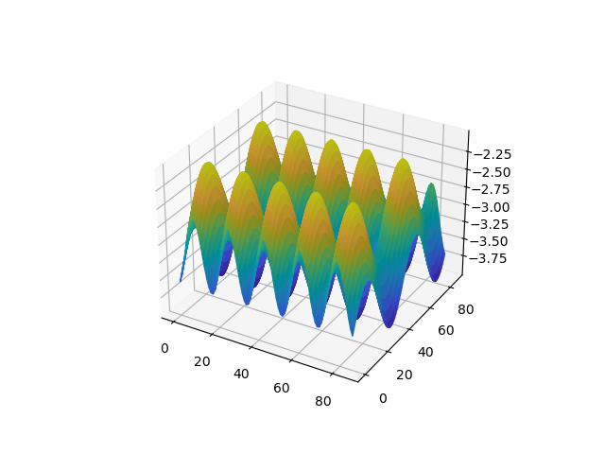
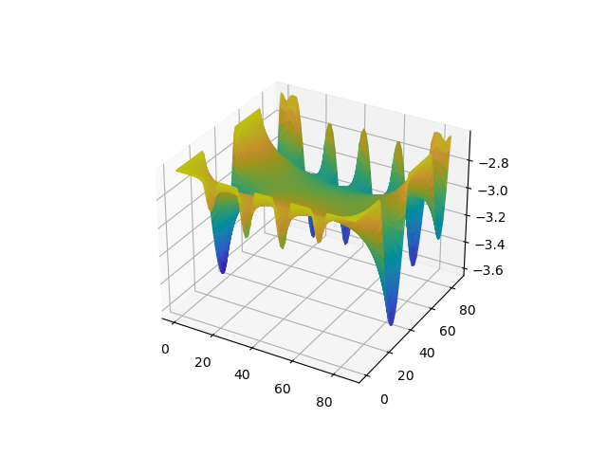
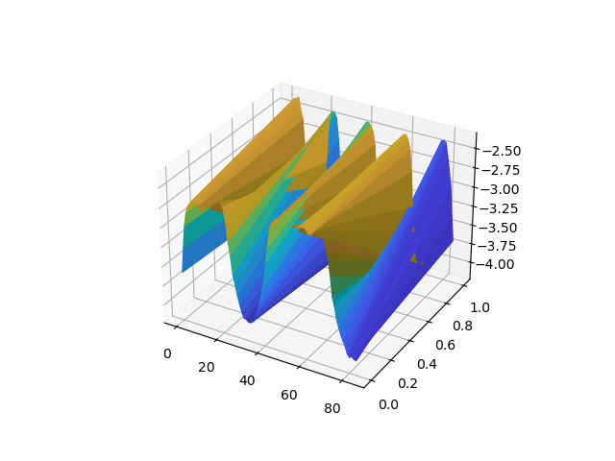
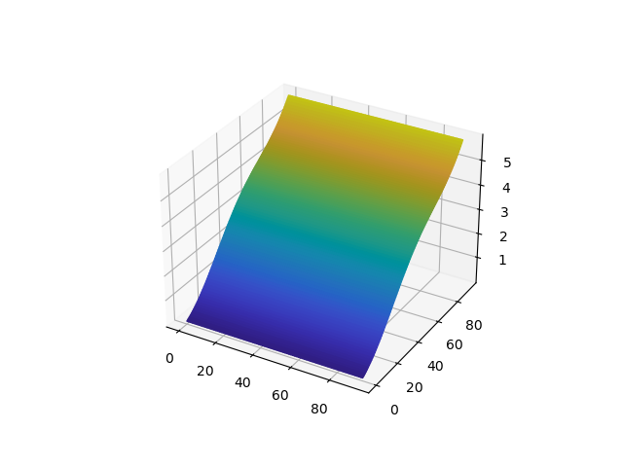
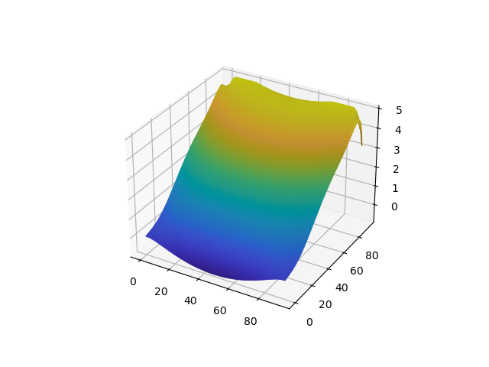
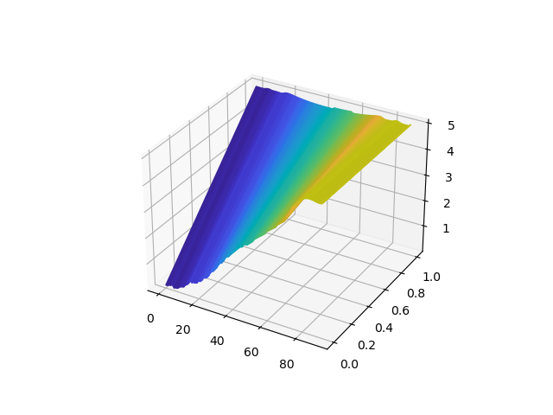
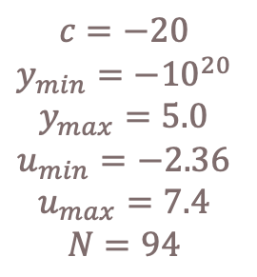
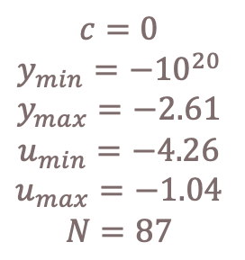
Results: Visualizing solutions
Desired
IPOPT
Proposed method
$$c=0 \\ y_{min}={−10}^{20} \\ y_{max}=−2.61 \\ u_{min}=−4.26 \\ u_{max}=−1.04 \\ N=87$$
Cost: 0.1972
Cost: 0.1815
$$c=−20 \\ y_{min}={−10}^{20} \\ y_{max}=5.0 \\ u_{min}=−2.36 \\ u_{max}=7.4 \\ N=94$$
Cost: 0.1452
Cost: 0.1241
Zenin Easa Panthakkalakath
16 June 2023
Notes:
Highlighting cases where the method has lower cost than IPOPT

Slide 20
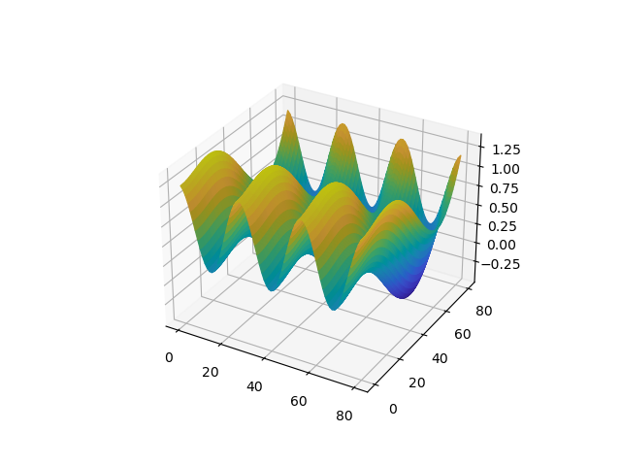
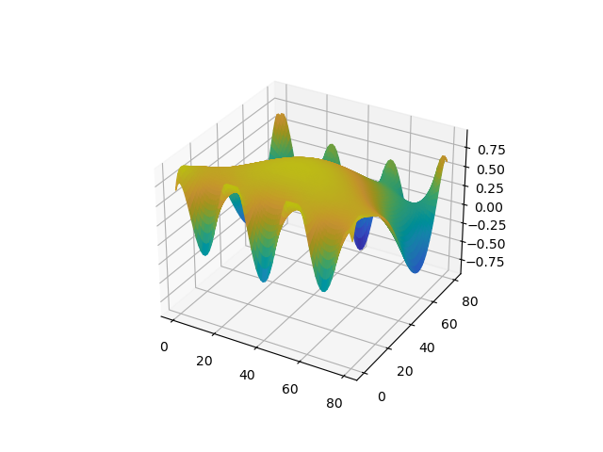
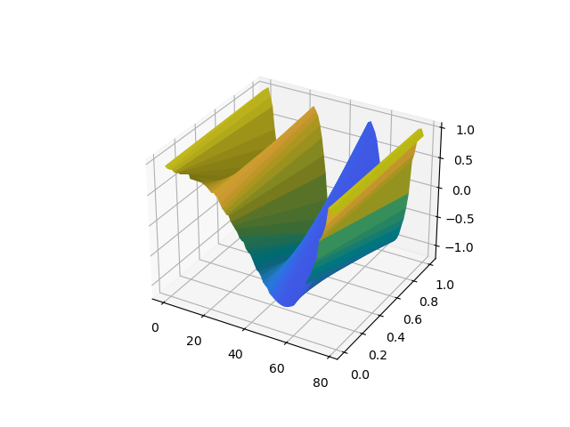
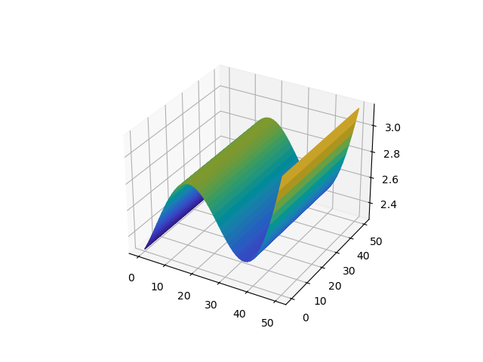
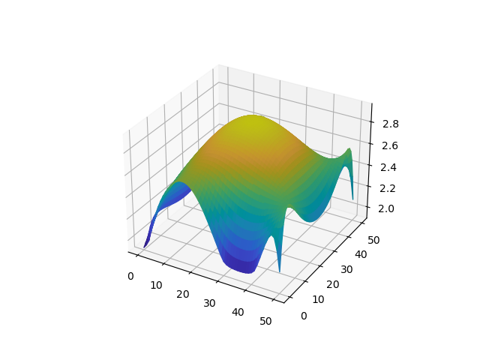
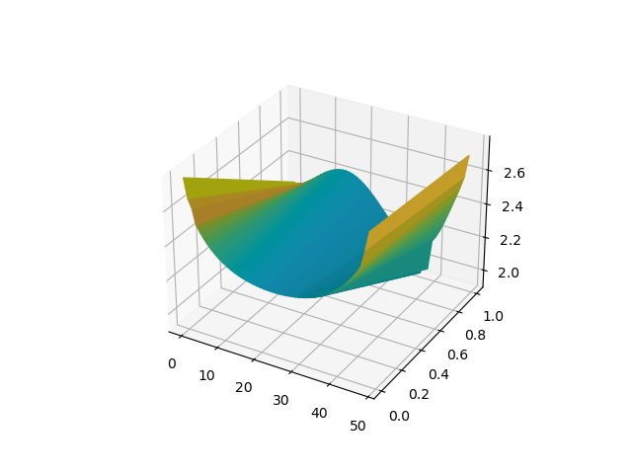
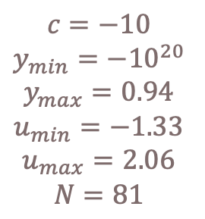
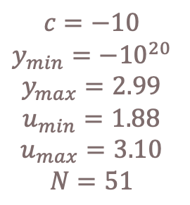
Results: Visualizing solutions
Desired
IPOPT
Proposed method
$$c=−10 \\ y_{min}={−10}^{20} \\ y_{max}=0.94 \\ u_{min}=−1.33 \\ u_{max}=2.06 \\ N=81$$
Cost: 0.1746
Cost: 0.1746
Cost: 0.1746
Cost: 0.1746
$$c=−10 \\ y_{min}={−10}^{20} \\ y_{max}=2.99 \\ u_{min}=1.88 \\ u_{max}=3.10 \\ N=51$$
Cost: 0.0604
Cost: 0.0604
Zenin Easa Panthakkalakath
16 June 2023
Notes:
Highlighting cases where the method and IPOPT have similar cost

Slide 21
Analysis: Comparative Analysis of Optimizer Network and IPOPT
Zenin Easa Panthakkalakath
16 June 2023
Notes:
In the 10000 problems generated, 5907 have feasible solutions
Cost predicted by proposed method with some constraint violation was lower than IPOPT in 3011 cases, which is 50.97% of the cases
Cost predicted by proposed method without any constraint violation was lower than IPOPT in 2127 cases, which is 36.01% of the cases

Slide 22
Analysis: Comparative Analysis of Optimizer Network and IPOPT
Standard axes
Logarithmic axes
Zenin Easa Panthakkalakath
16 June 2023

Slide 23
Analysis: Comparative Analysis of Optimizer Network and IPOPT
Zenin Easa Panthakkalakath
16 June 2023

Slide 24
Analysis: Iteration at which the network finds the best solution
With/without constraint violation
Without any constraint violation
Zenin Easa Panthakkalakath
16 June 2023
Notes:
The median number of iterations to get the lowest cost is calculated to be 28 and 26 for the lowest cost and the lowest cost without constraint violation, respectively.

Slide 25
Analysis: Iteration at which the network beats IPOPT
With/without constraint violation
Without any constraint violation
Zenin Easa Panthakkalakath
16 June 2023
Notes:
The median number of iterations to beat IPOPT’s cost value is calculated to be 13 and 12 iterations respectively for the case where there can be some constraint violation and the case where there can absolutely be no constraint violation.

Slide 26
Analysis: Timing and FLOPs
Zenin Easa Panthakkalakath
16 June 2023

Slide 27
Analysis: Affect on accuracy for larger domain sizes
Zenin Easa Panthakkalakath
16 June 2023

Slide 28
Analysis: Contribution of Adam, RMSProp and spatio-temporal parts
Inputs: u, g
(g is gradients of u w.r.t. cost)
Adam
Calculate g², g³
RMSProp
Conv+LSTM layer with ReLu activation
Conv+LSTM layer with ReLu activation
For four different problems
Conv layer with
ReLu activation
Multiplication with
sign of g
Linear layer
Input: empty
Output: Learning rates
Update u
Output: u
For 3200 iterations from different problems
Zenin Easa Panthakkalakath
16 June 2023

Slide 29
Another approach attempted
Agent-based modelling with Multi-Agent Deep Deterministic Policy Gradient
Attempt 1
Each cell are individual agents
Attempt 2
Each cells at the boundaries are individual agents
Attempt 3
A pair of boundary cells form an agent.
Zenin Easa Panthakkalakath
16 June 2023

Slide 30
Conclusions and Discussions
Pros:
Applied deep and reinforcement learning methods to solve boundary control problems
Method seems to have comparable accuracy to that of IPOPT in the range of values trained on.
Cons/Limitations:
Method does not seem to be working well when tested on large domain sizes for which the method was not trained on.
Using synthetic data has limitations
Lack of diversity
Introduces biasses
Mismatch with real-world conditions
Deep learning methods suffer from lack of interpretability and explainability.
Future work:
Creation/usage of more diverse real-world dataset for training and testing.
Improving the method to work with larger domain sizes.
Reduce computational cost of each iteration by using faster (or approximate)
PDE solvers
Methods to compute gradients
Create models that reaches the lowest cost with fewer iteration
More feature engineering
Different architecture
Revisit agent-based modelling approach.
Zenin Easa Panthakkalakath
16 June 2023

Slide 31
Thank you everyone! Please ask your questions…

Slide 32
#7e6c6c
#f87575
#ffa9a3
#b9e6ff
#5c95ff

Slide 33
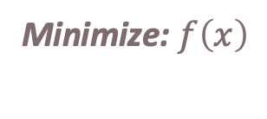
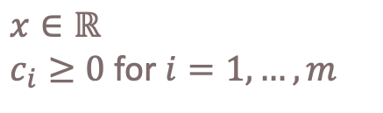
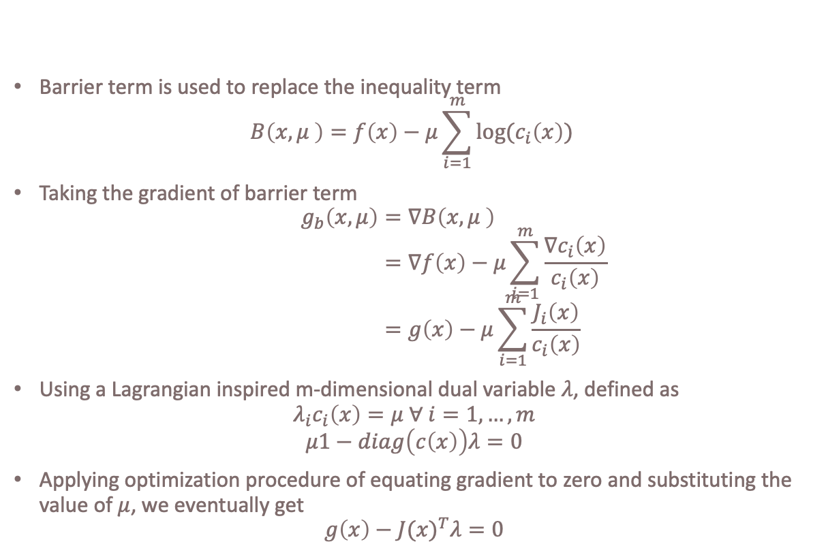
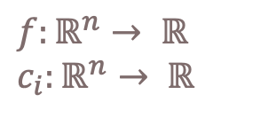
Interior Point Method (IPM)
Barrier term is used to replace the inequality term
$$B\left(x,μ \right)=f\left(x\right)−μ\sum_{i=1}^{m}{log⁡(c_{i}\left(x\right))}$$
Taking the gradient of barrier term
$$g_{b}\left(x,μ\right)=∇B\left(x,μ \right) \\ =∇f\left(x\right)−μ\sum_{i=1}^{m}{\frac{{∇c}_{i}\left(x\right)}{c_{i}\left(x\right)}} \\ =g\left(x\right)−μ\sum_{i=1}^{m}{\frac{J_{i}\left(x\right)}{c_{i}\left(x\right)}}$$
Using a Lagrangian inspired m-dimensional dual variable $λ$, defined as
$$λ_{i}c_{i}\left(x\right)=μ ∀ i=1,…,m$$
$$μ1−diag\left(c\left(x\right)\right)λ=0$$
Applying optimization procedure of equating gradient to zero and substituting the value of $μ$, we eventually get
$$g\left(x\right)−{J(x)}^{T}λ=0$$
Minimize: $f\left(x\right)$
Subject to:
$x∈ℝ$
$c_{i}≥0$ for $i=1, …,m$
$$f:ℝ^{n}→ ℝ$$
$$c_{i}:ℝ^{n}→ ℝ$$
Zenin Easa Panthakkalakath
16 June 2023

Slide 34
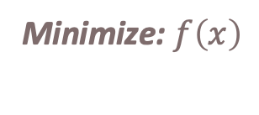
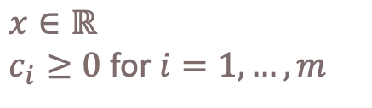
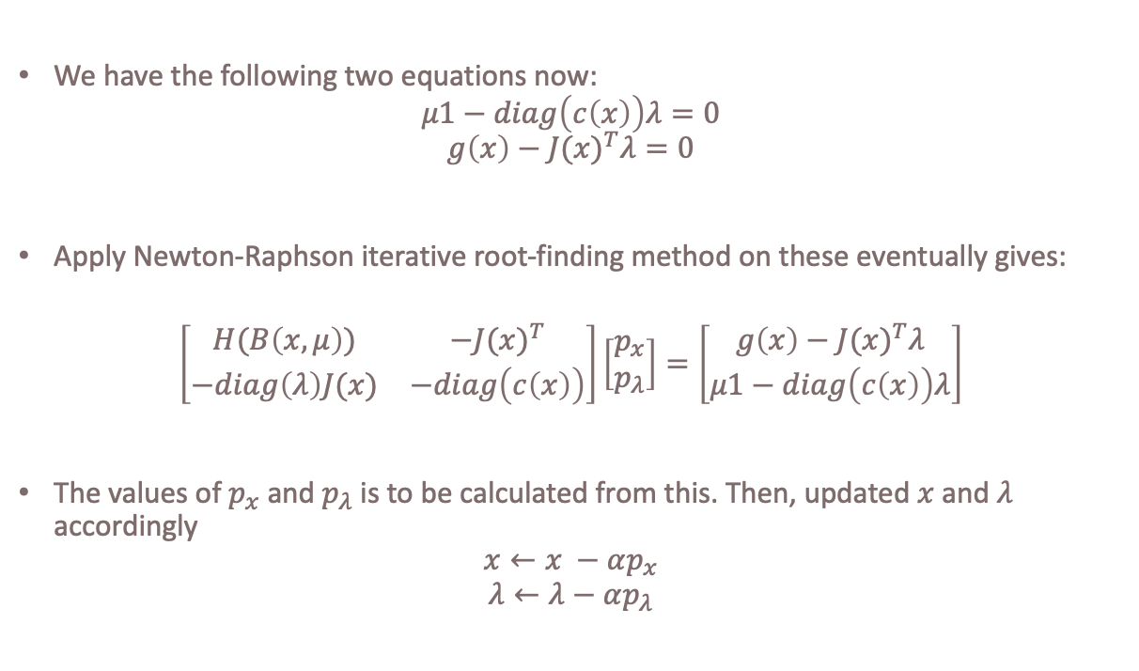
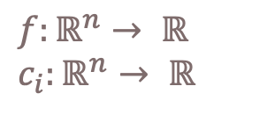
Interior Point Method (IPM)
We have the following two equations now:
$$μ1−diag\left(c\left(x\right)\right)λ=0$$
$$g\left(x\right)−{J(x)}^{T}λ=0$$
Apply Newton-Raphson iterative root-finding method on these eventually gives:
$$\left[\begin{matrix}H(B\left(x,μ\right)) & {−J(x)}^{T} \\ −diag\left(λ\right)J(x) & −diag\left(c\left(x\right)\right)\end{matrix}\right]\left[\begin{matrix}p_{x} \\ p_{λ}\end{matrix}\right]=\left[\begin{matrix}g\left(x\right)−{J(x)}^{T}λ \\ μ1−diag\left(c\left(x\right)\right)λ\end{matrix}\right]$$
The values of $p_{x}$ and $p_{λ}$ is to be calculated from this. Then, updated $x$ and $λ$ accordingly
$$x←x −αp_{x}$$
$$λ←λ−αp_{λ}$$
Minimize: $f\left(x\right)$
Subject to:
$x∈ℝ$
$c_{i}≥0$ for $i=1, …,m$
$$f:ℝ^{n}→ ℝ$$
$$c_{i}:ℝ^{n}→ ℝ$$
Zenin Easa Panthakkalakath
16 June 2023

Slide 35
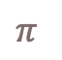
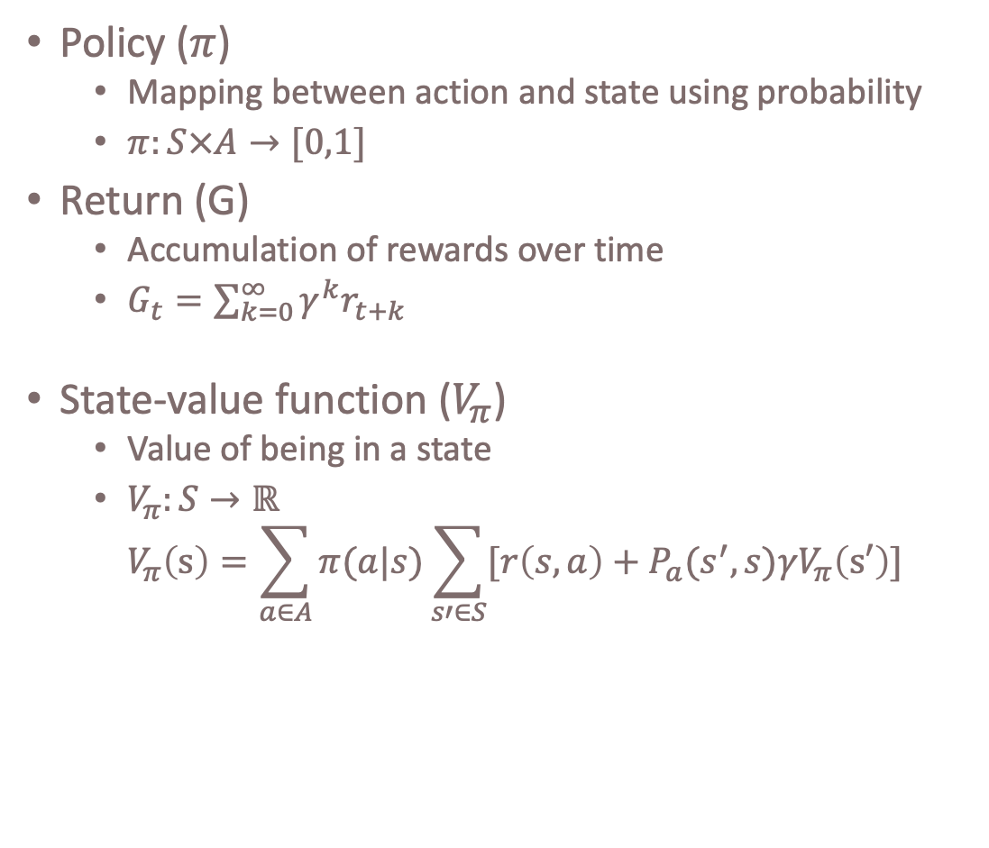
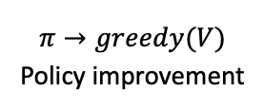
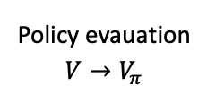

Reinforcement Learning
Policy ($π$)
Mapping between action and state using probability
$π:S×A→[0,1]$
Return (G)
Accumulation of rewards over time
$G_{t}=\sum_{k=0}^{∞}{γ^{k}r_{t+k}}$
State-value function ($V_{π}$)
Value of being in a state
$V_{π}:S→ℝ$ $V_{π}\left(s\right)=\sum_{a∈A}{π(a|s)}\sum_{s′∈S}{[r\left(s,a\right)+P_{a}(s^{′},s)γV_{π}\left(s′\right)]}$
Agent
Reward
Action
Environment
Policy evauation
$$V→V_{π}$$
$$π$$
$$V$$
$$π→greedy(V)$$
Policy improvement
Zenin Easa Panthakkalakath
16 June 2023

Slide 36
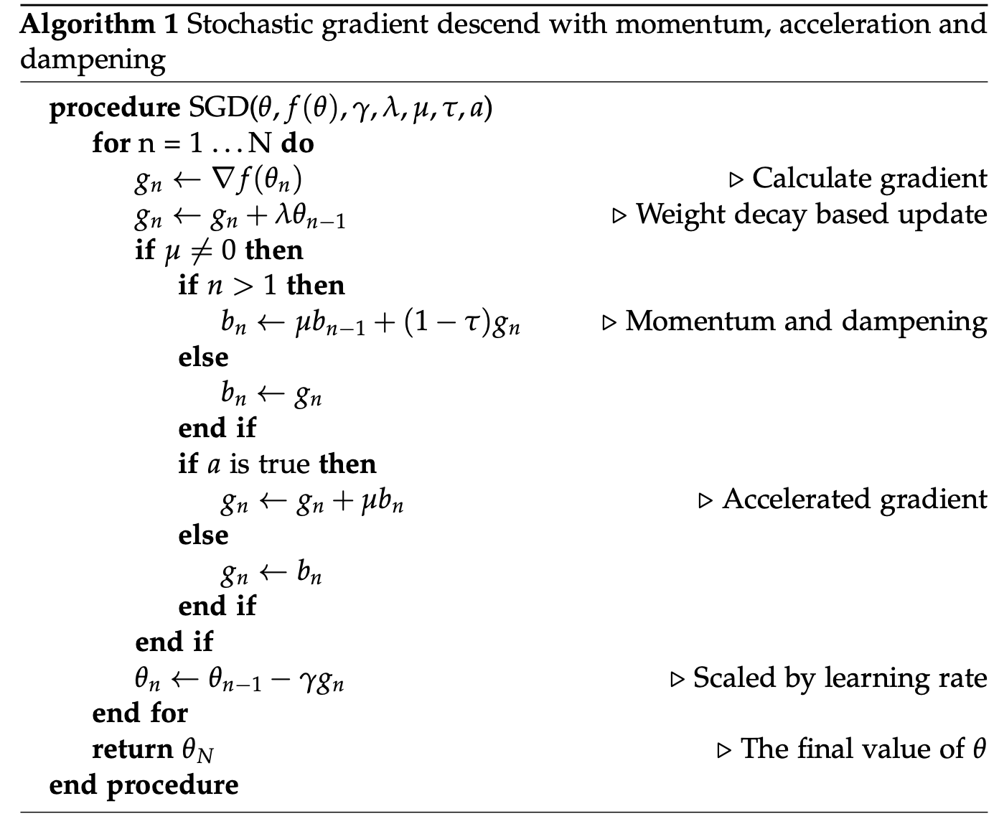
Stochastic Gradient Descend
Zenin Easa Panthakkalakath
16 June 2023

Slide 37

RMSProp
Zenin Easa Panthakkalakath
16 June 2023

Slide 38

Adam
Zenin Easa Panthakkalakath
16 June 2023

Slide 39

Methodology: Removing the effect of the sourcing term
Zenin Easa Panthakkalakath
16 June 2023

Slide 40
Analysis: Simple statistical analysis
In the 10000 problems generated, 5907 have feasible solutions
Cost predicted by proposed method with some constraint violation was lower than IPOPT in 3011 cases, which is 50.97% of the cases
Cost predicted by proposed method without any constraint violation was lower than IPOPT in 2127 cases, which is 36.01% of the cases
Zenin Easa Panthakkalakath
16 June 2023

Slide 41
Analysis: Timing
Initial guess network
Optimizer network
Zenin Easa Panthakkalakath
16 June 2023

Slide 42
Analysis: Timing
Zenin Easa Panthakkalakath
16 June 2023

Slide 43
Analysis: FLOPs
Initial guess network
Optimizer network
Zenin Easa Panthakkalakath
16 June 2023

Slide 44
Analysis: FLOPs
Zenin Easa Panthakkalakath
16 June 2023

Slide 45
Discussions: Limitations
Lack of interpretability and explainability
Synthetic data generated to train the networks
Lack of diversity
Introduce biasses
Mismatch with real-world conditions
Performance comparison may be flawed
Even if iterations are slower, if a method can get to a solution with fewer iterations, it can be better
Zenin Easa Panthakkalakath
16 June 2023

Slide 46
Conclusions
A method to solve boundary control problem was created in accordance with the skeleton of iterative optimization algorithms that utilizes Deep Learning and Reinforcement Learning methods.
The method seems to have comparable accuracy to that of IPOPT.
However, using synthetic data has its limitations and hence this claim should be taken with a pinch of salt.
The method does not seem to be working well when tested on large domain sizes for which the method was not trained on.
Zenin Easa Panthakkalakath
16 June 2023

Slide 47
Potential future work
Creation/usage of more diverse real-world dataset for training and testing.
Improving the method to work with larger domain sizes.
Reduce computational cost of each iteration by using faster (or approximate)
PDE solvers
Methods to compute gradients
Create models that reaches the lowest cost with fewer iteration
More feature engineering
Different architecture
Revisit agent-based modelling approach.
Zenin Easa Panthakkalakath
16 June 2023

Slide 48








Results: Visualizing solutions
Desired
IPOPT
Method
$$c=−10 \\ y_{min}={−10}^{20} \\ y_{max}=5.38 \\ u_{min}=2.71 \\ u_{max}=6.56$$
Cost: 0.1842
Cost: 0.1531
$$c=0 \\ y_{min}={−10}^{20} \\ y_{max}=−1.31 \\ u_{min}=−2.06 \\ u_{max}=−0.98$$
Cost: 0.0118
Cost: 0.0079
Zenin Easa Panthakkalakath
16 June 2023
Notes:
54,99,0.01,-1e+20,5.384021530228037,2.7111581008634427,6.558714834848072,-10,"5+-2*x1*x1+-1*x1+sin(4*pi*x1+pi/5)*sin(4*pi*x1+pi/5)",0.18424099683761597

